Slide 1
Recurrence Relations
CSI 219 – Discrete Mathematics
Course teacher: Minhajul Bashir

Slide 2

Bacteria in a colony
The number of bacteria doubles every hour
The colony begins with five bacteria
How many bacteria will be present after $n$ hours?

Slide 3
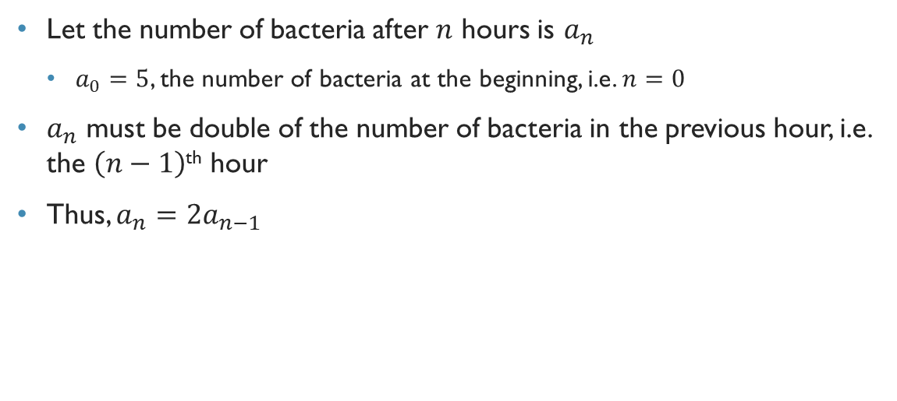
Bacteria in a colony
Let the number of bacteria after $n$ hours is $a_{n}$
$a_{0}=5$, the number of bacteria at the beginning, i.e. $n=0$
$a_{n}$ must be double of the number of bacteria in the previous hour, i.e. the $\left(n−1\right)$^{th} hour
Thus, $a_{n}=2a_{n−1}$

Slide 4
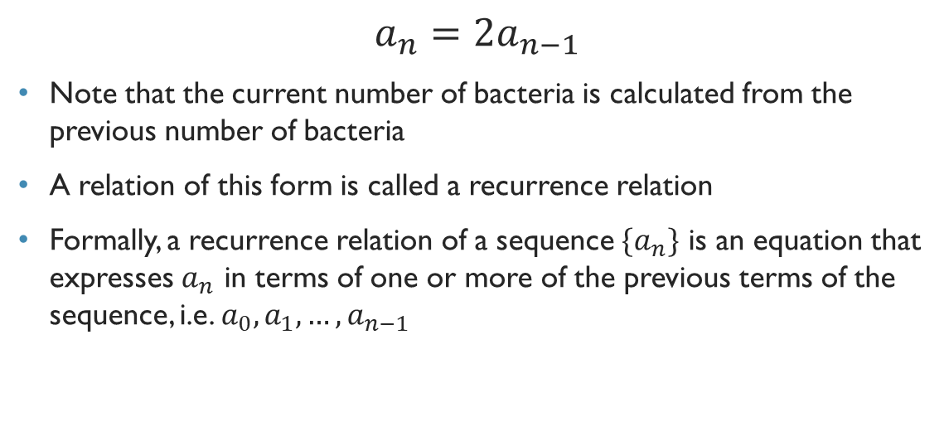
Recurrence relation
$$a_{n}=2a_{n−1}$$
Note that the current number of bacteria is calculated from the previous number of bacteria
A relation of this form is called a recurrence relation
Formally, a recurrence relation of a sequence $\{a_{n}\}$ is an equation that expresses $a_{n}$ in terms of one or more of the previous terms of the sequence, i.e. $a_{0},a_{1},…,a_{n−1}$

Slide 5

Quick exercise
If $a_{n}=a_{n−1}+a_{n−2}$, and $a_{0}=3$ and $a_{1}=5$, then find out the values of $a_{2},a_{3}$ and $a_{4}$

Slide 6
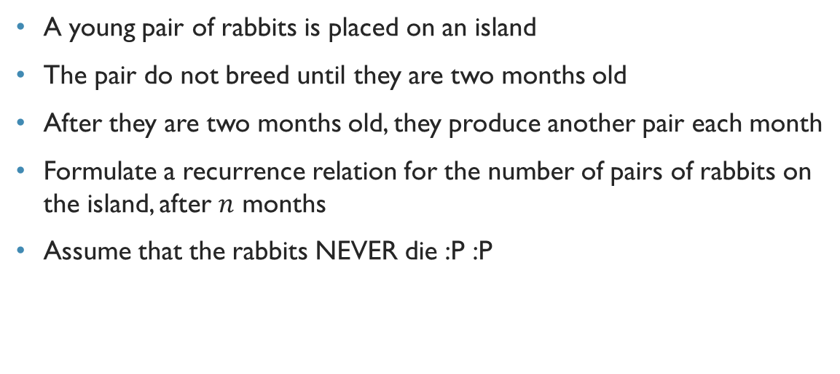
Rabbits in an island
A young pair of rabbits is placed on an island
The pair do not breed until they are two months old
After they are two months old, they produce another pair each month
Formulate a recurrence relation for the number of pairs of rabbits on the island, after $n$ months
Assume that the rabbits NEVER die :P :P

Slide 7

Month | Reproducing pairs | Young pairs | Total pairs
1 |  |  | 1
2 |  |  | 1
3 |  |  | 2
4 |  |  | 3
5 |  |  | 5
6 |  |  | 8

Slide 8
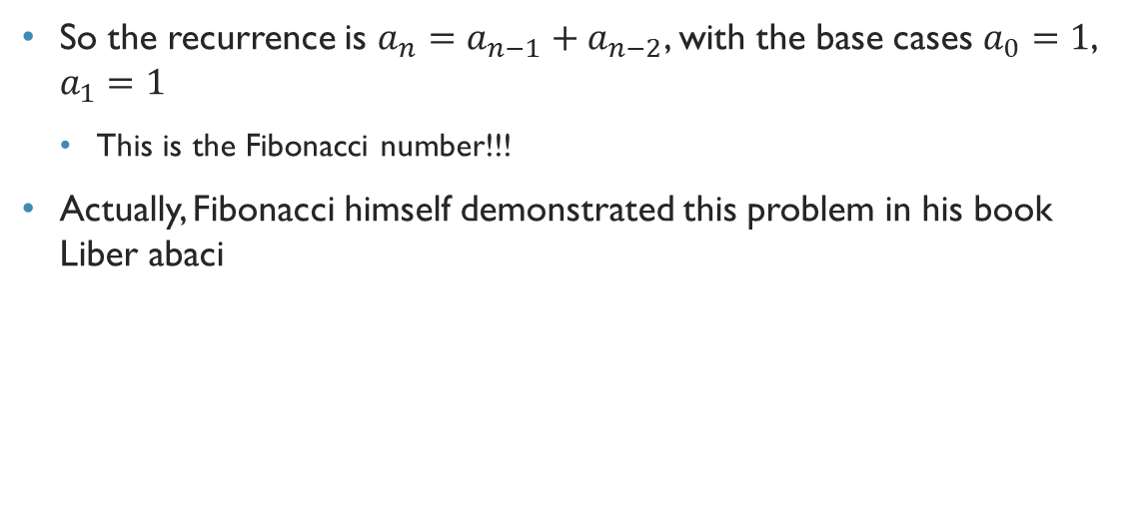
Rabbits in an island
So the recurrence is $a_{n}=a_{n−1}+a_{n−2}$, with the base cases $a_{0}=1$, $a_{1}=1$
This is the Fibonacci number!!!
Actually, Fibonacci himself demonstrated this problem in his book Liber abaci

Slide 9
পাটীগণিতে ফিরে যাওয়া

Slide 10
Exercise
A person deposits $10000 in a savings account in a bank
He yields 11% interest every year, with interest compounded annually
চক্রবৃদ্ধি মুনাফা
How much money will be in his account after 30 years?

Slide 11
The tower of hanoi
Target: Move disks from peg 1 to peg 3
Constraints:
Only one disk can be moved at a time
A disk must NOT be on a smaller disk
How to find out
the # of moves
using recurrence?

Slide 12
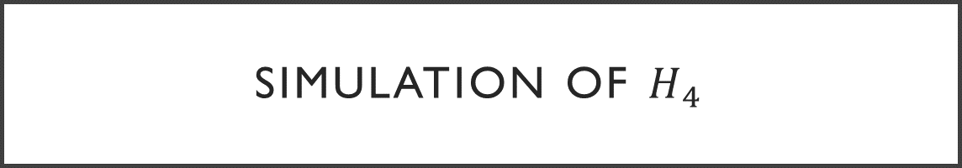
Simulation of $H_{4}$

Slide 13
Simulation of $H_{4}$

Slide 14
Simulation of $H_{4}$

Slide 15
Simulation of $H_{4}$

Slide 16
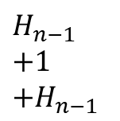
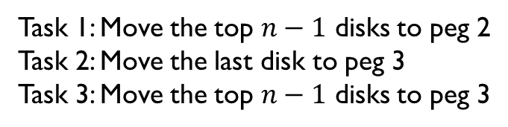

The tower of hanoi
Task 1: Move the top $n−1$ disks to peg 2
Task 2: Move the last disk to peg 3
Task 3: Move the top $n−1$ disks to peg 3
$H_{n−1}$
$+1$
$+H_{n−1}$
$$=2H_{n−1}+1$$

Slide 17
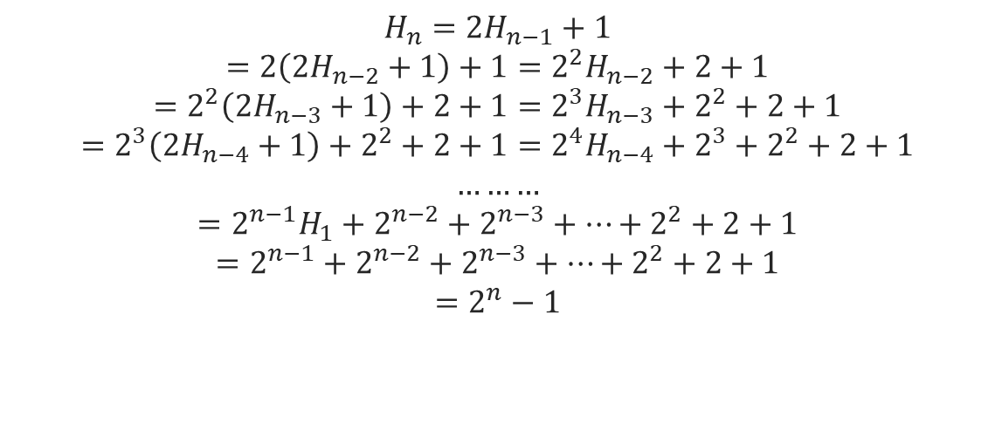
The tower of hanoi
$$H_{n}=2H_{n−1}+1$$
$$=2\left(2H_{n−2}+1\right)+1=2^{2}H_{n−2}+2+1$$
$$=2^{2}\left({2H}_{n−3}+1\right)+2+1=2^{3}H_{n−3}+2^{2}+2+1$$
$$=2^{3}\left(2H_{n−4}+1\right)+2^{2}+2+1=2^{4}H_{n−4}+2^{3}+2^{2}+2+1$$
$$………$$
$$=2^{n−1}H_{1}+2^{n−2}+2^{n−3}+…+2^{2}+2+1$$
$$=2^{n−1}+2^{n−2}+2^{n−3}+…+2^{2}+2+1$$
$$=2^{n}−1$$

